Slide 1


Human-like Controllable Image Captioning
with Verb-specific Semantic Roles
Zhejiang University, Tencent AI Lab
CVPR 2021

Slide 2

目录 | CONTENT
1
Introduction
2
Approach
3
Experiments
4
Conclusions

Slide 3
Introduction
Image Captioning
Image captioning, i.e., generating fluent and meaningful descriptions to summarize the salient contents of an image, is a classic proxy task for comprehensive scene understanding.
Controllable Image Captioning (CIC)
Current captioning models tend to produce generic descriptions, and fail to control the caption generation process as humans.
CIC aims generates image descriptions following designated control signals.

Slide 4
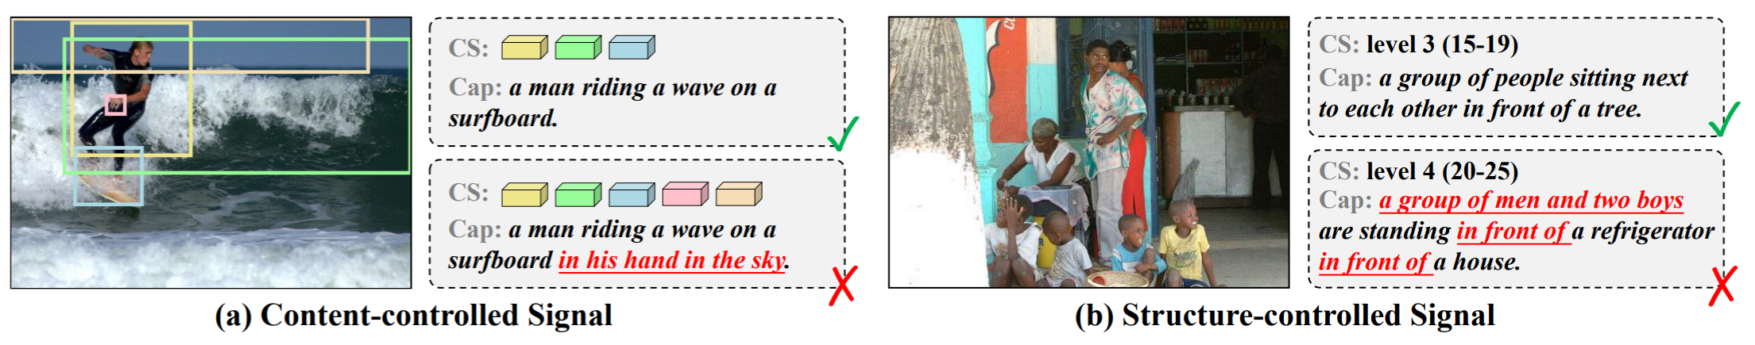
Introduction
Content-controlled
Structure-controlled
The control signals are about the contents of interest which need to be described.
The control signals are about the semantic structures of sentences.
All visual contents referred to in a single sentence should be compatible with the described activity.
The control signals should be suitable for the specific image sample.
Event-compatible
Sample-suitable

Slide 5
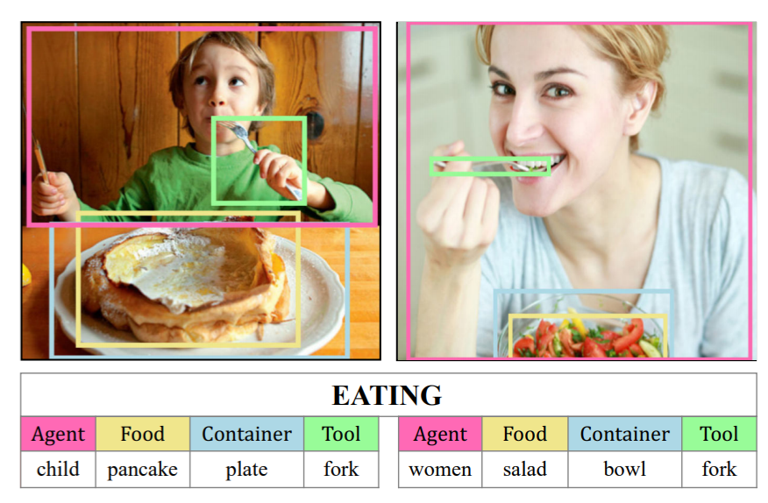
Introduction
How humans describe images?
Our brains always quickly structure a descriptive pattern like “STH DO
STH AT SOMEPLACE” first, and then fill in the detailed description.

Slide 6
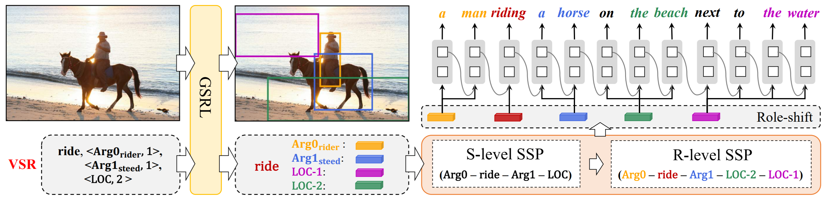


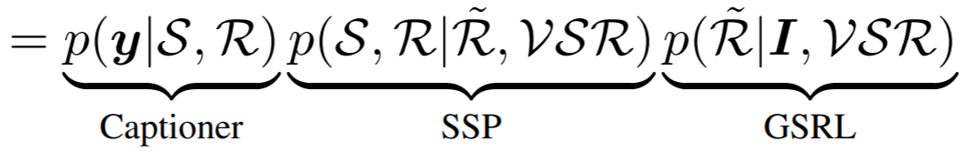
Approach
The verbs are predicted by an off-the-shelf action recognition network and verb-specific semantic roles can be retrieved from the verb lexicon such as PropBank.

Slide 7
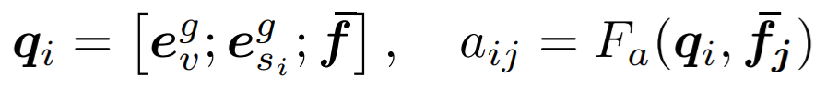


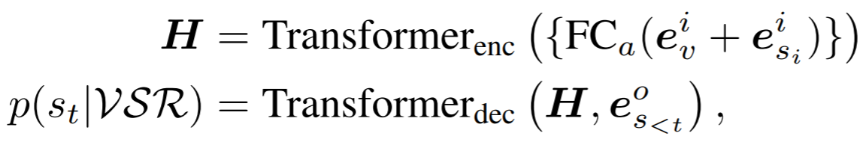
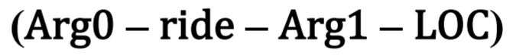


Approach
1. Grounded Semantic Role Labeling (GSRL)
where $e_{v}^{g}$ and $e_{si}^{g}$ are the word embedding features of verb $v$ and semantic role$s_{i}$, $\overline{f}$ and ${\overline{f}}_{j}$ represent the average-pooled visual features of proposal set $\text{B}$ and ${\text{B}}_{j}$.
2. Semantic Structure Planner (SSP)
2.1. Sentence-level SSP
2.1. Role-level SSP

Slide 8
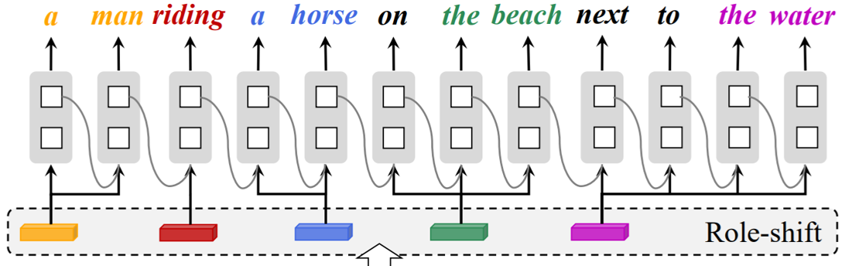
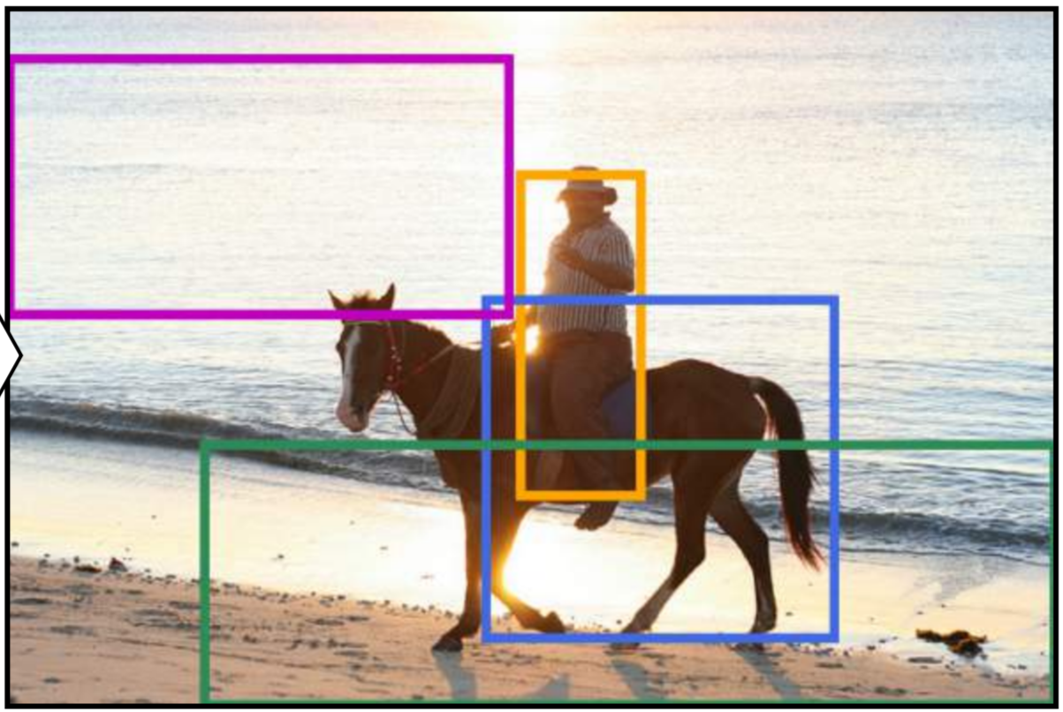
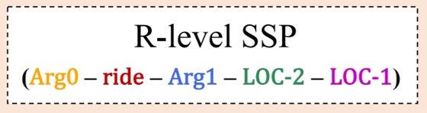
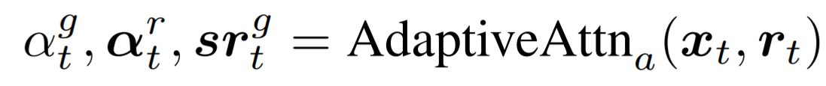
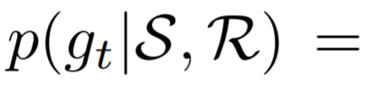
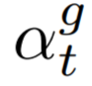
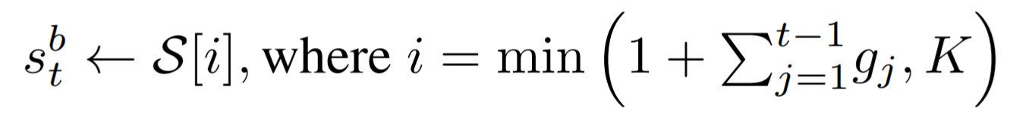
Approach
3. Role-shift Caption Generation
3.1. Role-shift

Slide 9
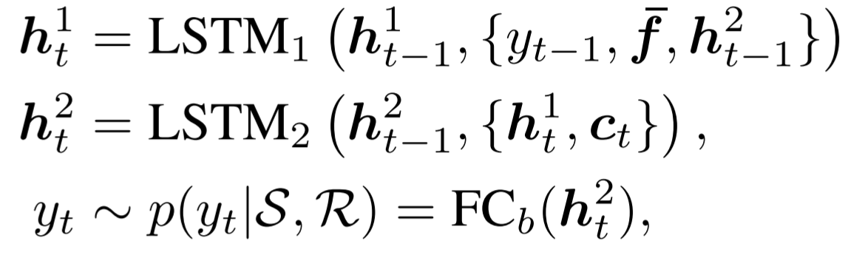
Approach
3.2. Caption Generation

Slide 10
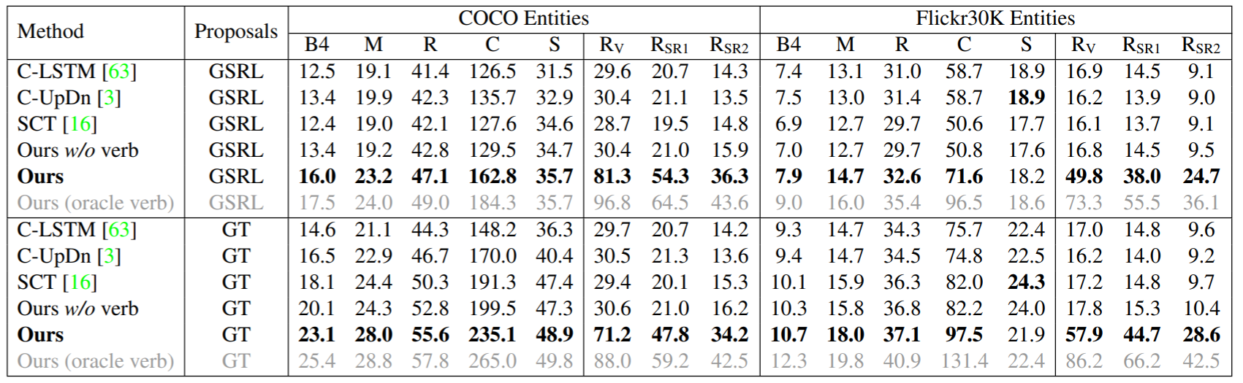
Experiments
Performance Comparison

Slide 11
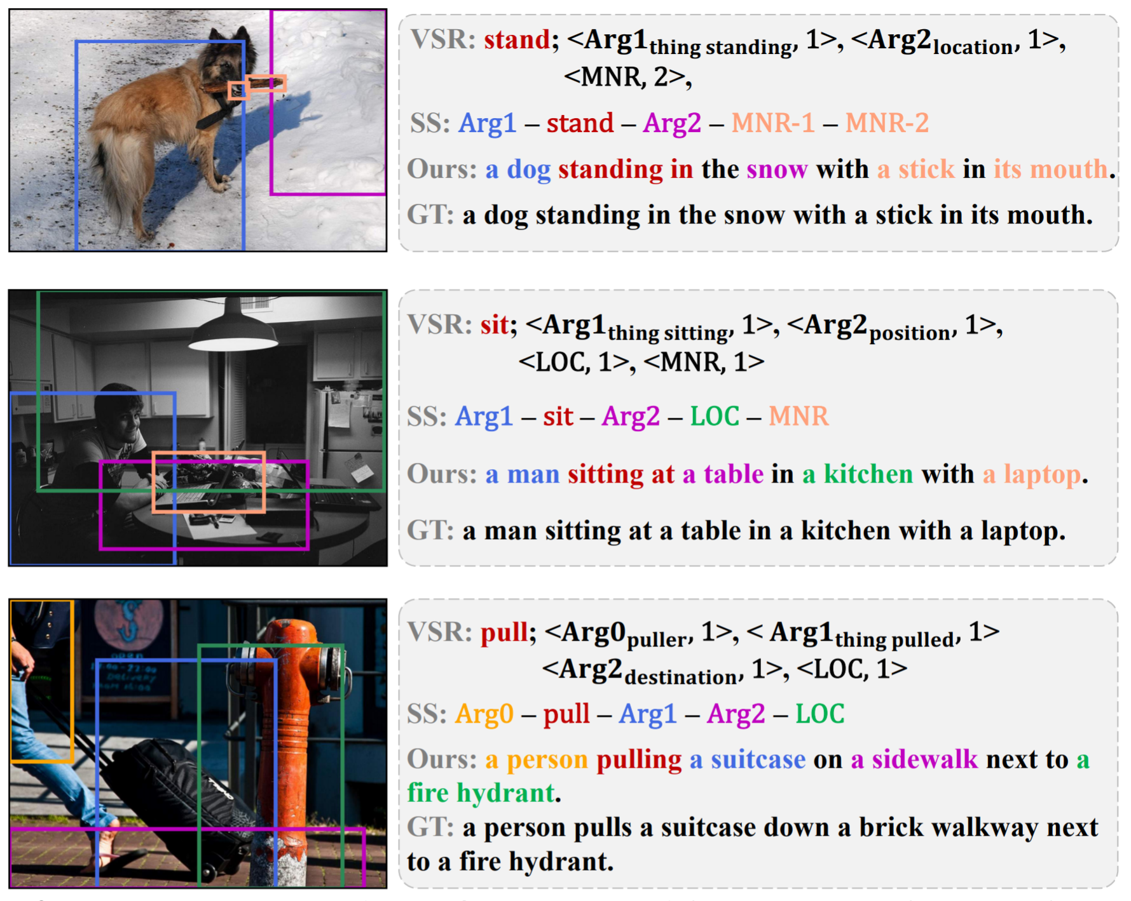
Experiments
Examples

Slide 12

谢谢聆听
Thank You
张亚东

